Slide 1

DEPARTMENT OF MATHEMATICS
SGGSJ GOVERNMENT COLLEGE
PAONTA SAHIB

Slide 2
COURSE NAME : VECTOR CALCULUS
COURSE CODE : 310TH

Slide 3
CONTENTS
Curl of a vector point function.
Irrotational vector.
Problem based on curl of a function.

Slide 4
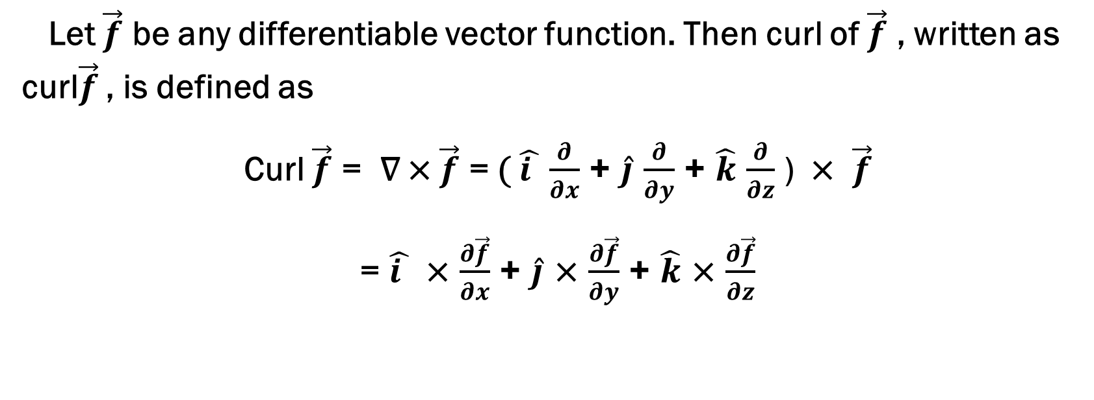
CURL OF A VECTOR POINT FUNCTION
Let $\vec{f}$ be any differentiable vector function. Then curl of $\vec{f}$ , written as curl$\vec{f}$ , is defined as
Curl $\vec{f}$ = ∇ × $\vec{f}$ = ( $\hat{i }$ $\frac{∂}{∂x}$ + $\hat{j}$ $\frac{∂}{∂y}$ + $\hat{k}$ $\frac{∂}{∂z}$ ) × $\vec{f}$
= $\hat{i }$ × $\frac{∂\vec{f}}{∂x}$ + $\hat{j}$ × $\frac{∂\vec{f}}{∂y}$ + $\hat{k}$ × $\frac{∂\vec{f}}{∂z}$

Slide 5
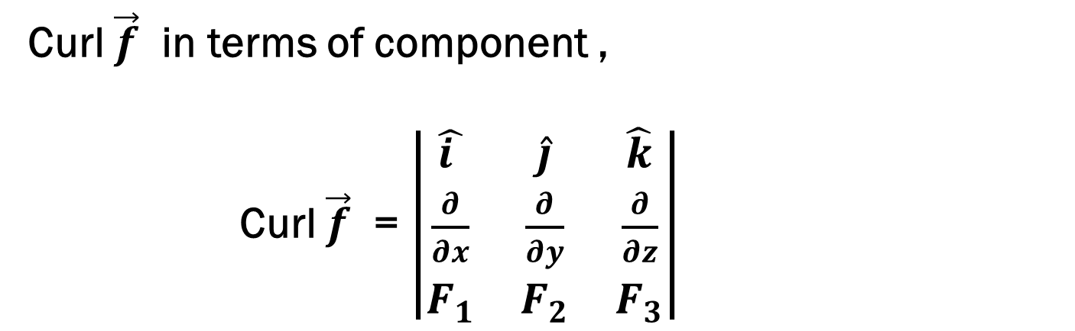
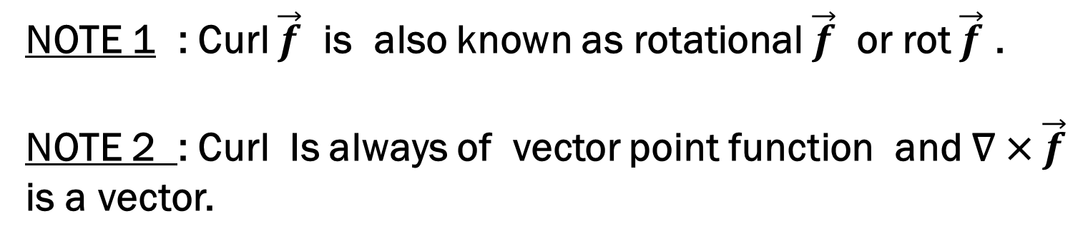
NOTE 1 : Curl $\vec{f}$ is also known as rotational $\vec{f}$ or rot $\vec{f}$ .
NOTE 2 : Curl Is always of vector point function and ∇ × $\vec{f}$ is a vector.
Curl $\vec{f}$ in terms of component ,
Curl $\vec{f}$ = $\left|\begin{matrix}\hat{i } & \hat{j} & \hat{k} \\ \frac{∂}{∂x} & \frac{∂}{∂y} & \frac{∂}{∂z} \\ F_{1} & F_{2} & F_{3}\end{matrix}\right|$

Slide 6
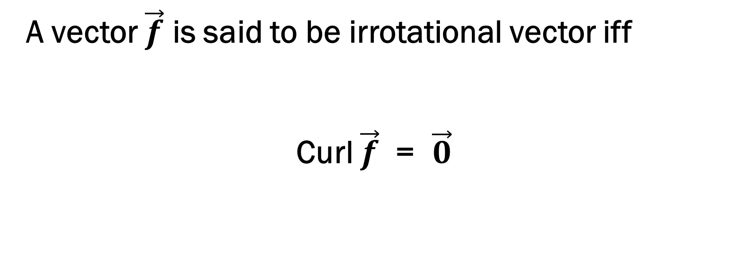
Irrotational vector :
A vector $\vec{f}$ is said to be irrotational vector iff
Curl $\vec{f}$ = $\vec{0}$

Slide 7
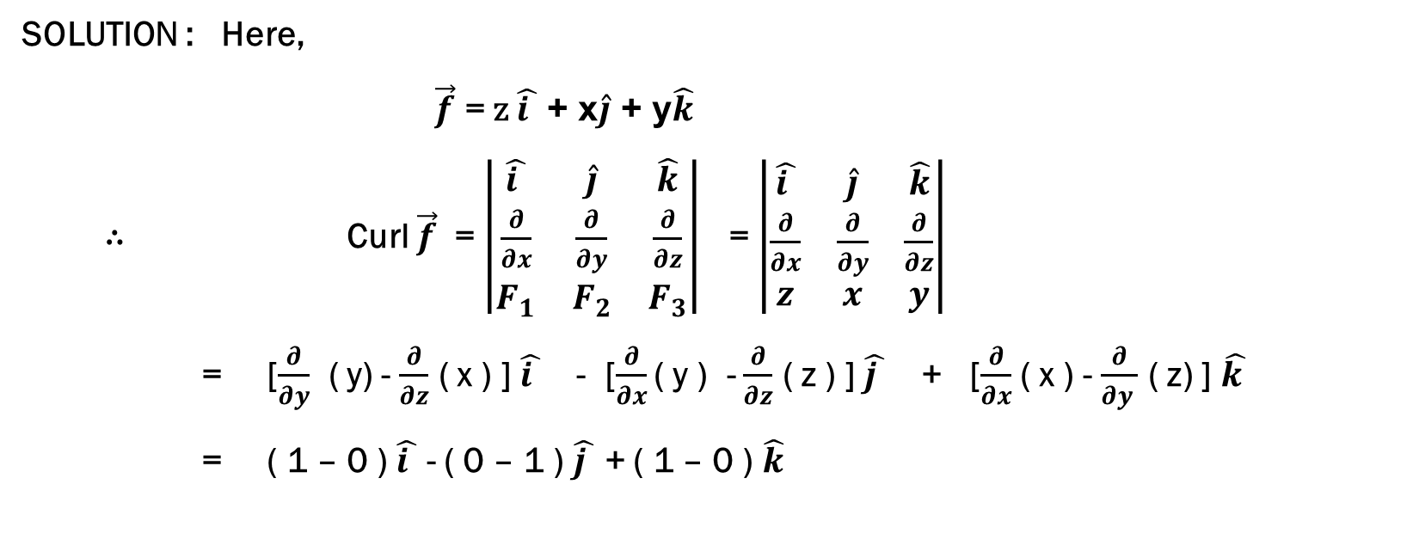

PROBLEM 1 : Prove that curl curl $\vec{f}$ = $\vec{0}$ ,
Where $\vec{f}$ = z $\hat{i }$ + x$\hat{j}$ + y$\hat{k}$.
SOLUTION : Here,
$\vec{f}$ = z $\hat{i }$ + x$\hat{j}$ + y$\hat{k}$
∴ Curl $\vec{f}$ = $\left|\begin{matrix}\hat{i } & \hat{j} & \hat{k} \\ \frac{∂}{∂x} & \frac{∂}{∂y} & \frac{∂}{∂z} \\ F_{1} & F_{2} & F_{3}\end{matrix}\right|$ = $\left|\begin{matrix}\hat{i } & \hat{j} & \hat{k} \\ \frac{∂}{∂x} & \frac{∂}{∂y} & \frac{∂}{∂z} \\ z & x & y\end{matrix}\right|$
= [$\frac{∂}{∂y}$ ( y) - $\frac{∂}{∂z}$ ( x ) ] $\hat{i }$ - [$\frac{∂}{∂x}$ ( y ) - $\frac{∂}{∂z}$ ( z ) ] $\hat{j }$ + [$\frac{∂}{∂x}$ ( x ) - $\frac{∂}{∂y }$ ( z) ] $\hat{k }$
= ( 1 – 0 ) $\hat{i }$ - ( 0 – 1 ) $\hat{j }$ + ( 1 – 0 ) $\hat{k}$

Slide 8
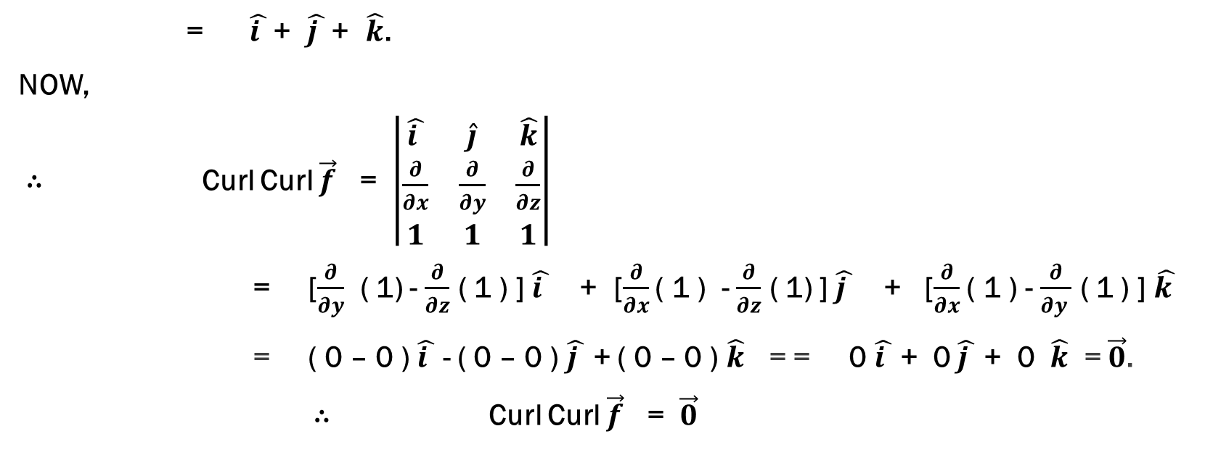
SOLUTION CONTINUES…
= $\hat{i }$ + $\hat{j }$ + $\hat{k}$.
NOW,
∴ Curl Curl $\vec{f}$ = $\left|\begin{matrix}\hat{i } & \hat{j} & \hat{k} \\ \frac{∂}{∂x} & \frac{∂}{∂y} & \frac{∂}{∂z} \\ 1 & 1 & 1\end{matrix}\right|$
= [$\frac{∂}{∂y}$ ( 1) - $\frac{∂}{∂z}$ ( 1 ) ] $\hat{i }$ + [$\frac{∂}{∂x}$ ( 1 ) - $\frac{∂}{∂z}$ ( 1) ] $\hat{j }$ + [$\frac{∂}{∂x}$ ( 1 ) - $\frac{∂}{∂y }$ ( 1 ) ] $\hat{k }$
= ( 0 – 0 ) $\hat{i }$ - ( 0 – 0 ) $\hat{j }$ + ( 0 – 0 ) $\hat{k}$ = = 0 $\hat{i }$ + 0 $\hat{j }$ + 0 $\hat{k}$ = $\vec{0}$.
∴ Curl Curl $\vec{f}$ = $\vec{0}$

Slide 9
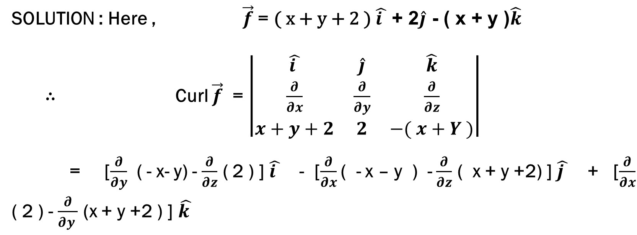
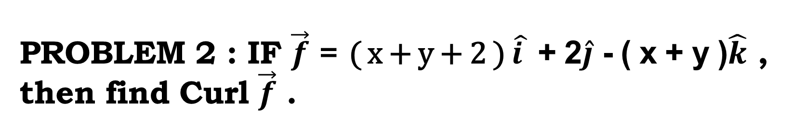
PROBLEM 2 : IF $\vec{f}$ = ( x + y + 2 ) $\hat{i }$ + 2$\hat{j}$ - ( x + y )$\hat{k}$ , then find Curl $\vec{f}$ .
SOLUTION : Here , $\vec{f}$ = ( x + y + 2 ) $\hat{i }$ + 2$\hat{j}$ - ( x + y )$\hat{k}$
∴ Curl $\vec{f}$ = $\left|\begin{matrix}\hat{i } & \hat{j} & \hat{k} \\ \frac{∂}{∂x} & \frac{∂}{∂y} & \frac{∂}{∂z} \\ x+y+2 & 2 & −( x+Y )\end{matrix}\right|$
= [$\frac{∂}{∂y}$ ( - x- y) - $\frac{∂}{∂z}$ ( 2 ) ] $\hat{i }$ - [$\frac{∂}{∂x}$ ( - x – y ) - $\frac{∂}{∂z}$ ( x + y +2) ] $\hat{j }$ + [$\frac{∂}{∂x}$ ( 2 ) - $\frac{∂}{∂y }$ (x + y +2 ) ] $\hat{k }$

Slide 10
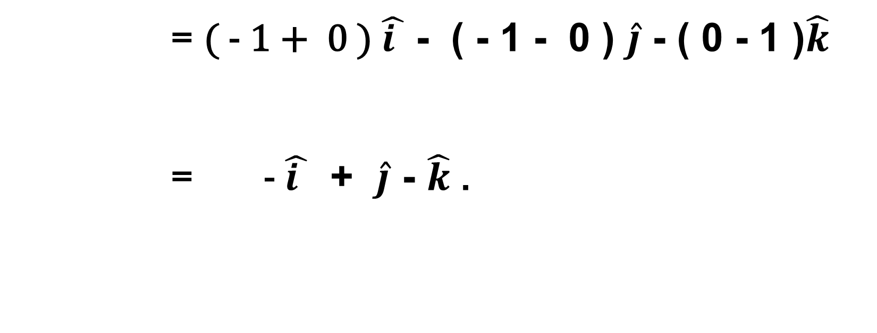
SOLUTIONS CONTINUES…
= ( - 1 + 0 ) $\hat{i }$ - ( - 1 - 0 ) $\hat{j}$ - ( 0 - 1 )$\hat{k}$
= - $\hat{i }$ + $\hat{j}$ - $\hat{k}$ .

Slide 11
THANKYOU

